Slide 1

Final Presentation
Nitai Gildor – 318657780
Itamar Morag - 316526557

Slide 2


Solution Descriptions and Principles of Operation
General idea
  Accelerator that holds 8 “cores”, each core specialized to perform the Waterman-Smith Algorithm simultaneously with a query (same for all cores) and a reference (different per core)
Hardware acceleration
  Smith-Waterman modified algorithm: We implemented the algorithm in the hardware, while using only the necessary tiles for each calculation, instead of saving all the tiles.
  8-Way Parallel Processing: We built 8 independent hardware cores that run at the same time, allowing us to evaluate all 8 reference sequences against the query simultaneously.
  Dynamic Early Stop: The hardware reads the actual sequence lengths to dynamically shrink the calculation grid (e.g., stopping at 8x8 instead of 16x16), saving cycles and preventing inaccurate alignments.
  Data Transfer (I/O): We accelerated bus communication by packing 16-letter DNA sequences into single 32-bit writes, and packing the final results into 6-bit scores to minimize read times.

Slide 3
Solution Descriptions and Principles of Operation
Software computation
  Fast Data Packing: Before sending data to the accelerator, the CPU compresses 16-letter DNA sequences into a single 32-bit chunk using a fast, loop-free bitwise trick.
  Fast Data Unpacking: Instead of reading 8 separate score registers over the slow system bus, the CPU reads just 2 packed registers and uses simple bit-shifting to extract all 8 final scores.
  Transfer query and reference lengths using 2 registers to ensure proper calculation for different lengths with minimal write overhead.

Slide 4
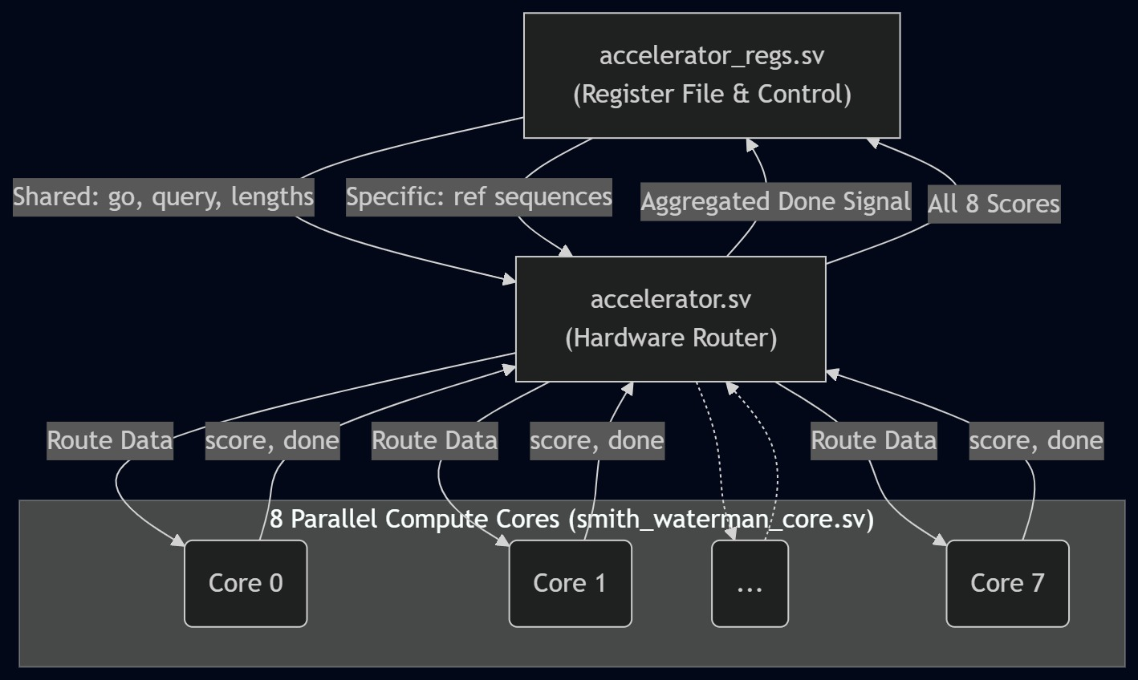
Microarchitectural and Design Solution

Slide 5
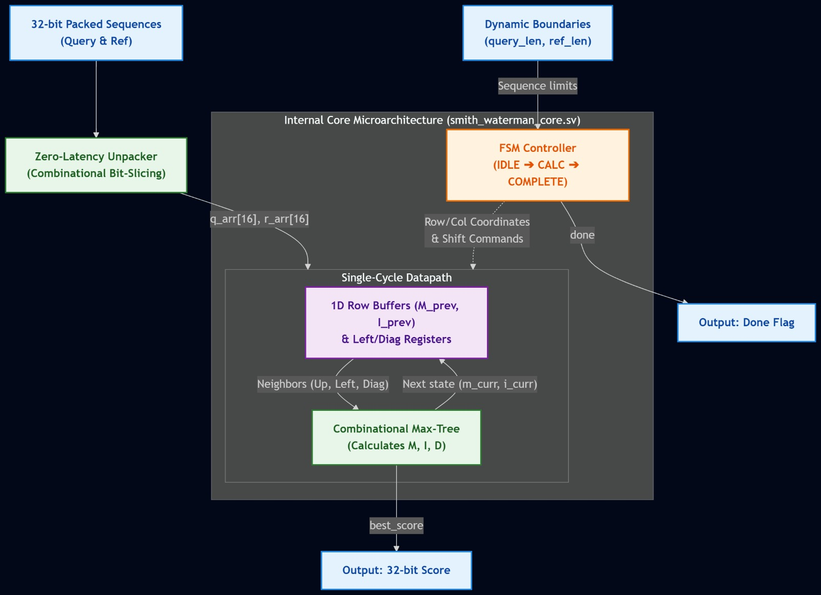
Microarchitectural and Design Solution

Slide 6
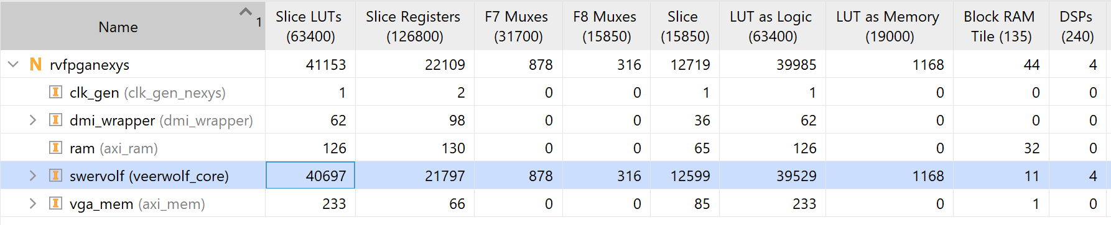
Results Summary
Metric | Results
Total latency of the full workload | 3469
Hardware resources:

Slide 7
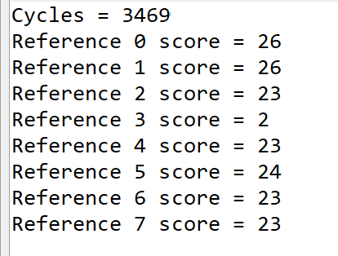
Output Run Screen Shot

